Slide 1
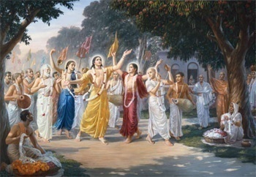
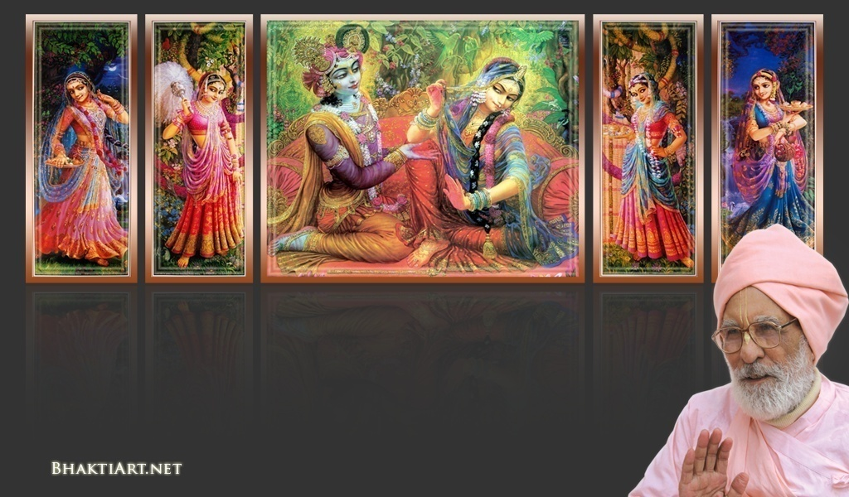
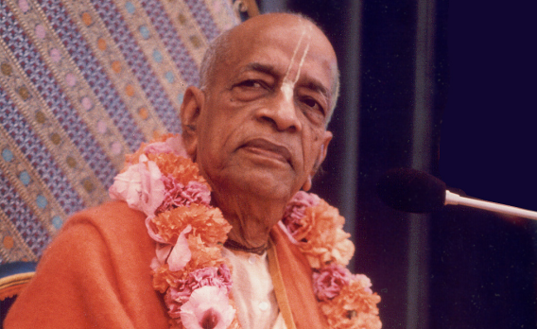
Sri Krsna Caitanya Prabhu Nityananda
Sri Advaita Gadadara Srivasadi
Gaura Bhakta Vrinda
Hare Krsna Hare Krsna
Krsna Krsna Hare Hare
Hare Rama Hare Rama
Rama Rama Hare Hare
Gokul Bhajan & Vedic Studies
North Carolina, USA
Notes:
Om Ajnana timirandhasya, jnananjana salakaya
Caksur unmimiltam yena, tasmai sri gurave namah
Namah om vishnu padaya, radhikayah priyatmane
Sri-srimad bhaktivedanta, narayana iti namine
Sri krishna lila kathane sudaksham
Audarya-madhurya gunais ca yuktam
Varam varenyam purusham mahantam
Narayanam tvam sirasa namami
He krishna karuna sindho, dina bandho jagat pate
Gopesha gopika kanta, radha kanta namo ‘stu te
tapta kancana gaurangi, radhe vrindavaneshvari
vrsabhanu sute devi, pranamami hari priye
bhajami radham aravinda netram
smarami radham madhurasmi-tasyam
vadami radham karuna bharardram
tato mam anyasti gatir na kapi
bhaktya vihina aparadha lakshai
ksiptas ca kamadi taranga madhye
krpamayi tvam saranam prapanna
vrinde numas te caranara vindam

Slide 2
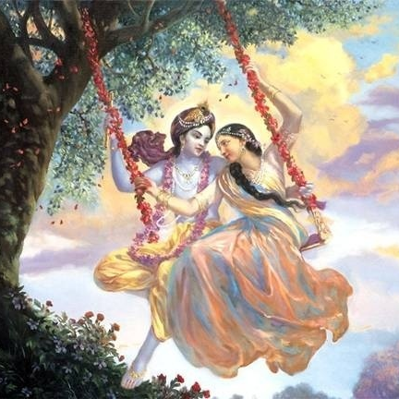
Jaya Rādha Mādhava
Jaya Kunja Vihārī
Jaya Gopī Jana Vallabha
Jaya Giri Vara Dhārī ... (Jaya)
Yaśodā Nandana Vraja Jana Ranjana
Yamunā tīra Vana Cāri ... (Jaya)
[ Hare Krishna Hare Krishna
Krishna Krishna Hare Hare
Hare Rāma Hare Rāma
Rāma Rāma Hare Hare ]

Slide 3
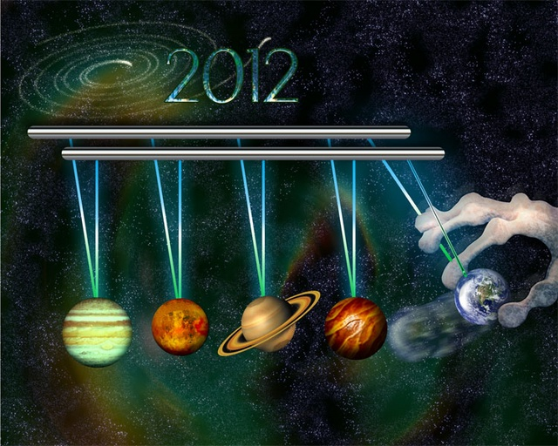
What happened to Dec 21, 2012?
Week# 248 - Jan 04, 2013

Slide 4
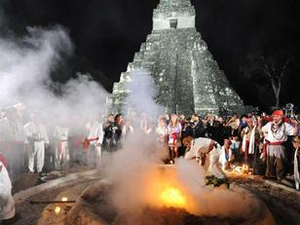
Thousands of people joined and damaged the ancient Mayan temples

Slide 5
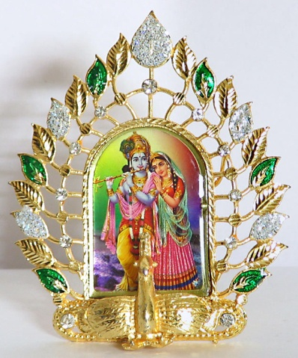
2013

Slide 6
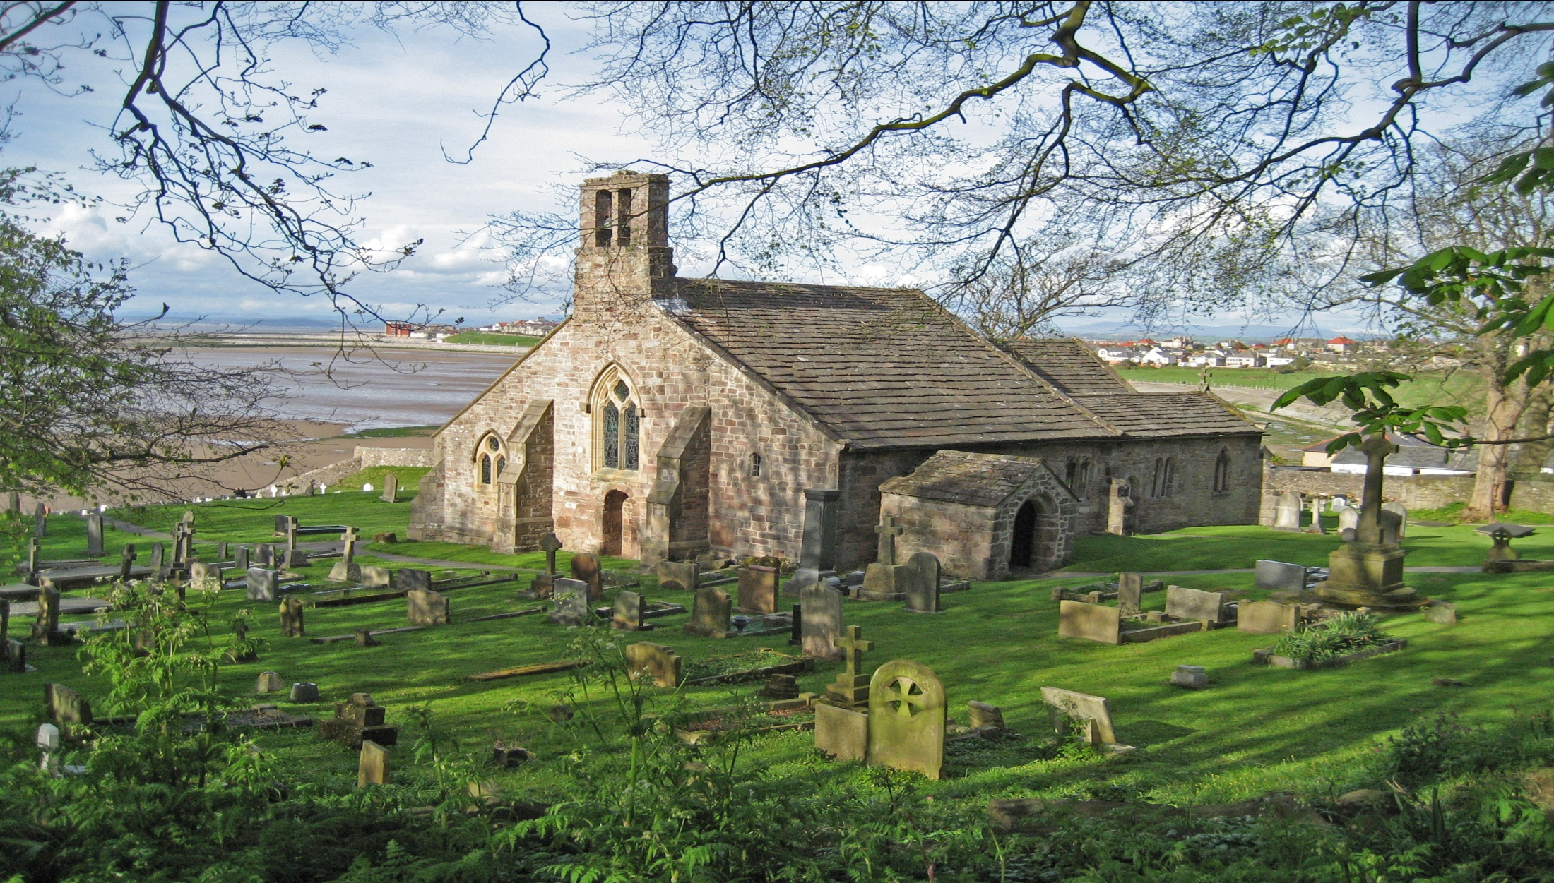
A man was visiting a strange village. In the middle was a church and grave yard!

Slide 7
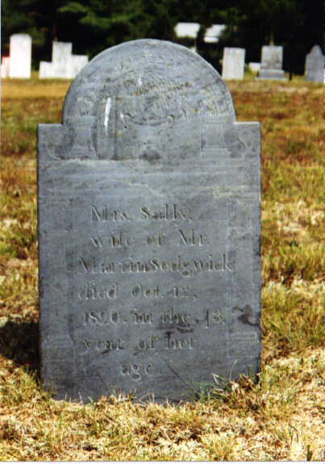
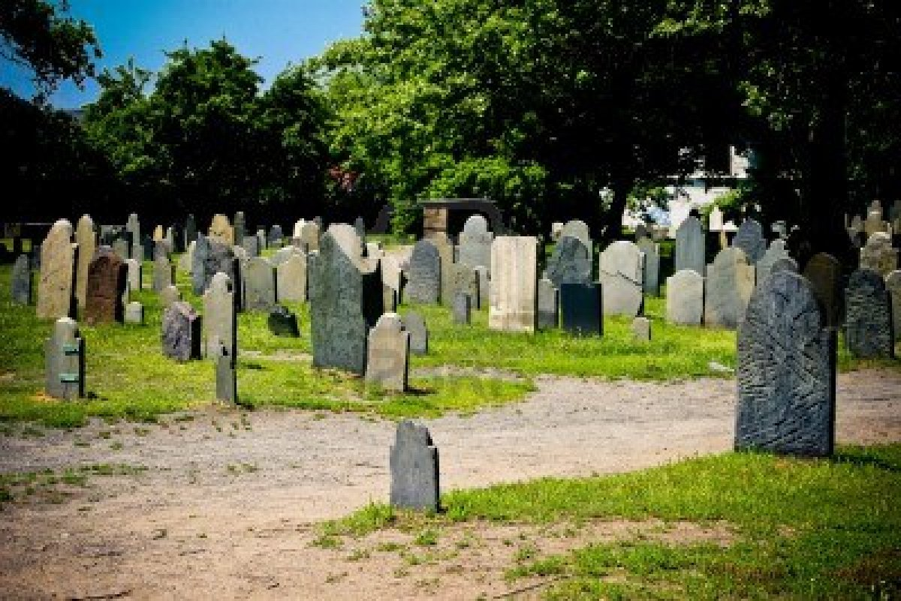
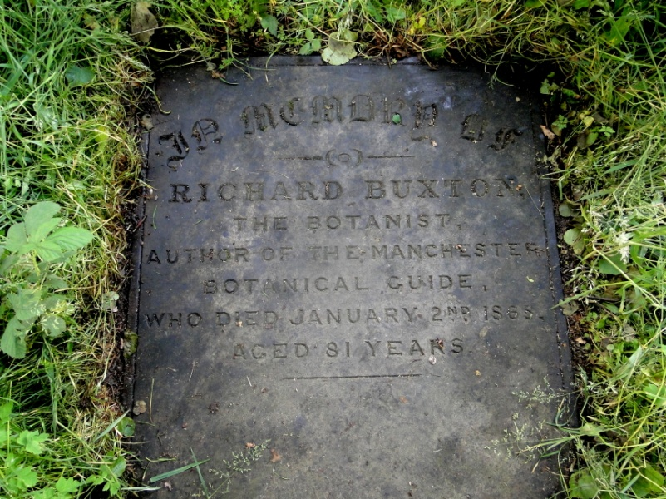
He found strange on the graves
Elizebeth Gordan
Born: 19-07-1795
Died: 11-09-1859
Lived: 6 days
John White
Born: 12-04-1821
Died: 16-12-1919
Lived: 9 months

Slide 8
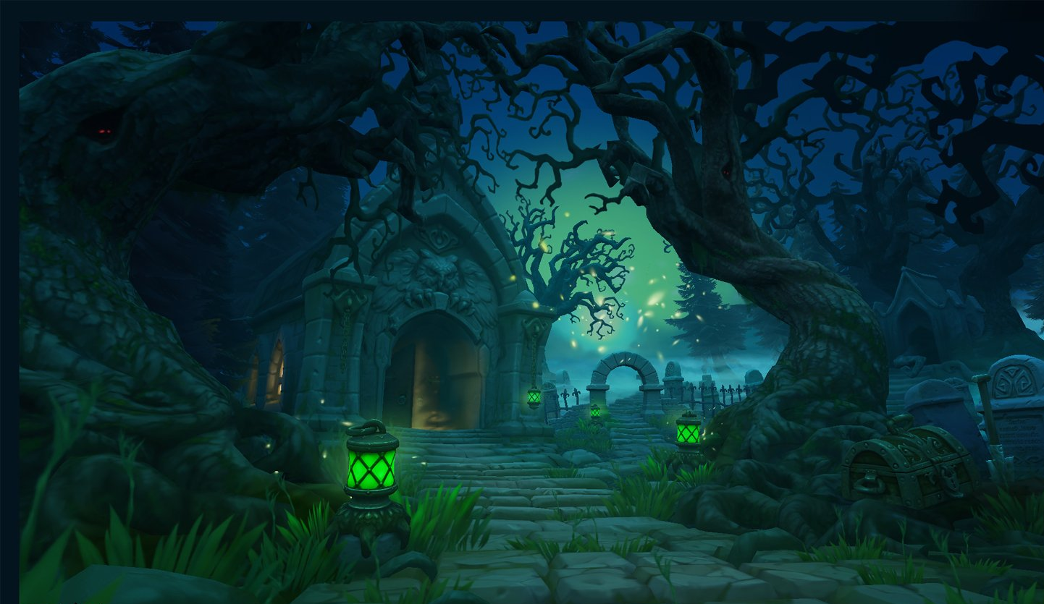
Lived time = Time spent in prayer and devotion to God!

Slide 9
How much time I am really living?
Out of 24 hours in a day..
I need at least 8 hours for sleep!
And 8 plus hours for work
1 hour for driving
2 hours for TV and News!
Plus 2 full hours for gossip
Otherwise my head will break for sure!
2 hours for my favorite Soap Opera
Plus 2 hours for email & internet..
Oh my God! Where is my time for doing my shopping?
I have not yet even eaten!
O God! Why did you give me only 24 hours in a day?
If you gave more, I would have used it for You!
Sorry God!
I don’t have time for the prayer!
I really swear you!
I don’t have any time for You!
If I find any time, I can write the prayer on a wall
So that you Youself can read it all !

Slide 10
What is the GOAL of human life?
Hurray! 2012 has gone!
Looking for 2014..!

Slide 11
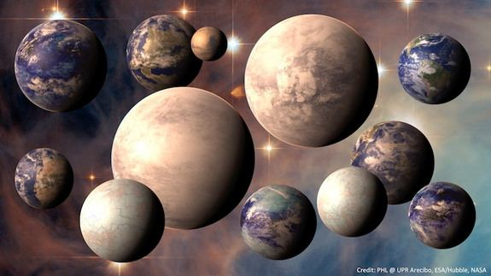
Now scientists say: There are at least 100 Billion Alien planets in our milky way itself!
Do you want to live in every one of them?

Slide 12
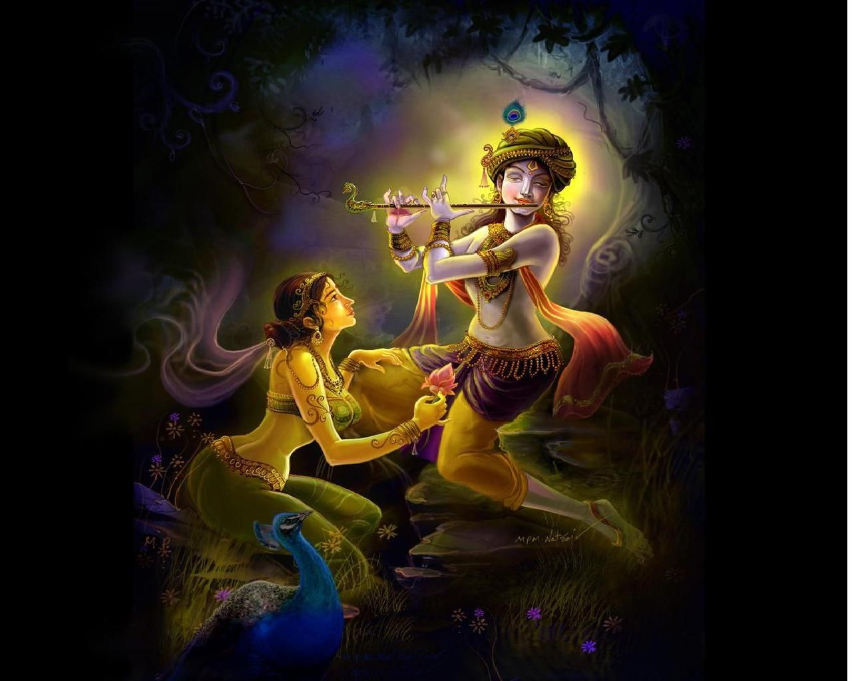
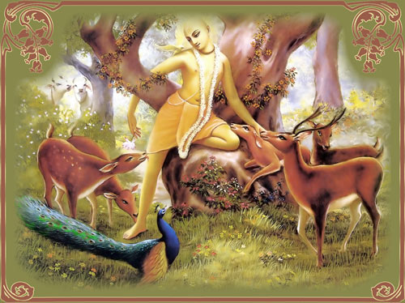
What is the topmost goal of Jiva?
Krishna Prema!
Our very nature is serving!
Jivera svarupa haya
Krsnera nitya dasa
Serve with Prema!

Slide 13
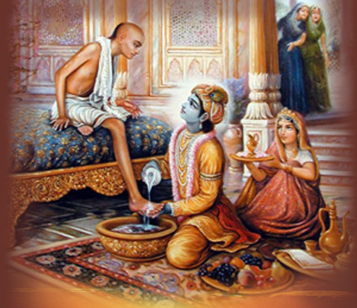
There are only 2 things important
Prabhu kahe vaiṣṇava sevā
Nāma sankirtana
Dui kara śīghra pābe
Śrī Krṣṇa caraṇa

Slide 14
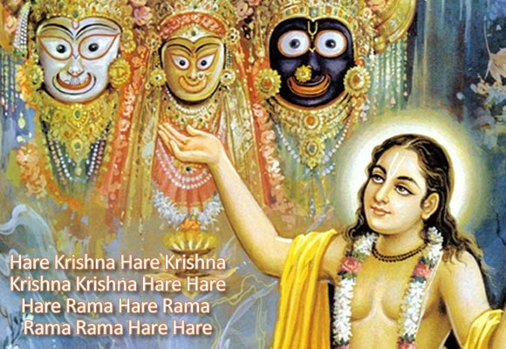
3 mins

Slide 15
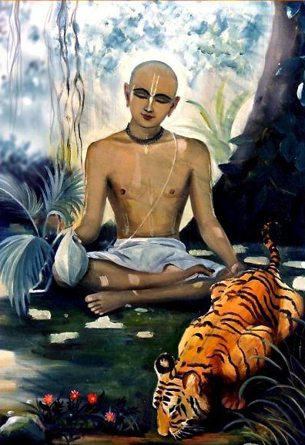
How many names did Namacharya Haridas Thakur chant minimum everyday?
300,000
(3 Lakhs)
About 180 rounds

Slide 16
Why am I not able to chant ?
Nama Aparadha
Vaishnava Aparadha
Pride
Ego
and so on…

Slide 17
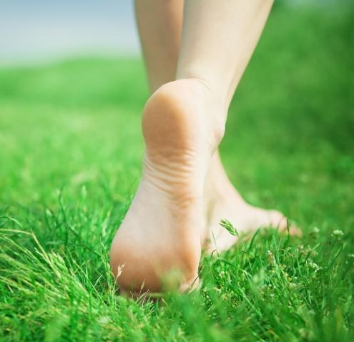
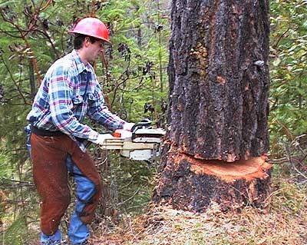
Who can chant ?
Trṇād api sunīcena
Taror api sahiṣṇunā
Amāninā mānadena
Kīrtanīyah sadā harih

Slide 18
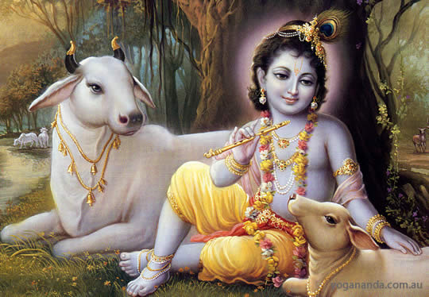
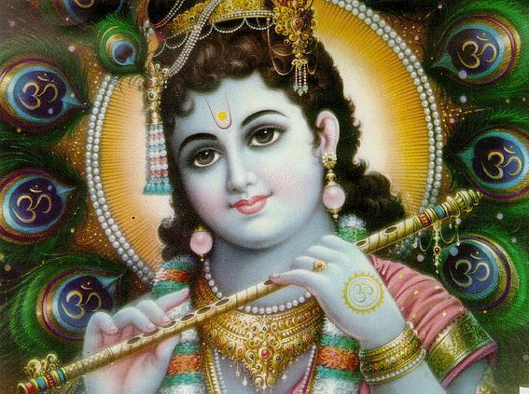
Kṛṣṇa Kanhaiyā Jaya Gopāl
Kanhaiyā Lāla Sri Gopāl
Jaya Gopāl Jaya Jaya Gopāl,
Jaya Jaya Jaya Jaya Śrī Gopāl ..(Kṛṣṇa)
Yaśodā Nandana Jaya Gopāl
Yamunā Tīra Sri Gopāl
Gokula Rakṣaka Jaya Gopāl
Govardhana Dhara Sri Gopāl .. (Kṛṣṇa)
Nandana Bāla Jaya Gopāl
Navanīta Cora Sri Gopāl
Ksira Śayana Jaya Gopāl
Kṛṣṇa Keśava Sri Gopāl .. (Kṛṣṇa)
E-18

Slide 19
Gita
Krishna
Arjuna
Gurudeva
Gokula
Bhakta
Sankirtana
Vrindavana
Govardana
Radhakunda
We are going to play a small game now!
Each child should have one 5x7 index card and a pencil..

Slide 20
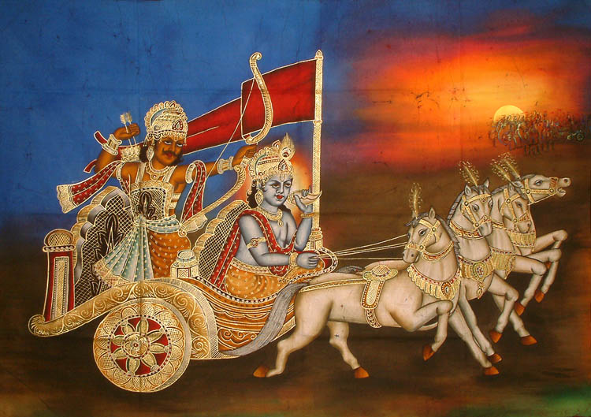
Essence of Gita

Slide 21
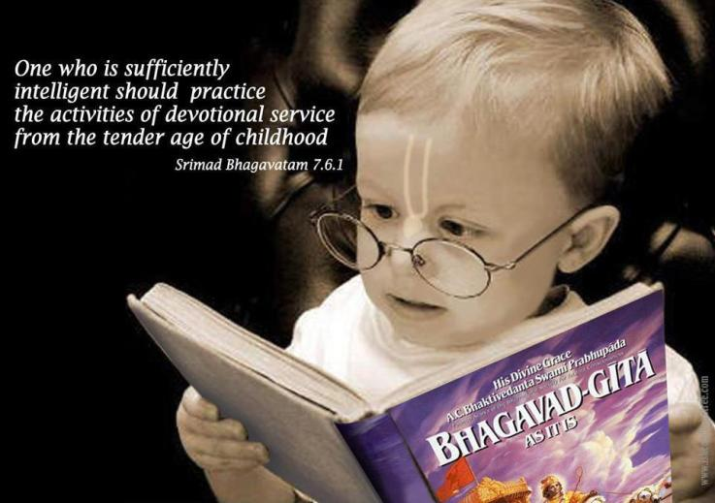
Who should read Bhagavad Gita?

Slide 22
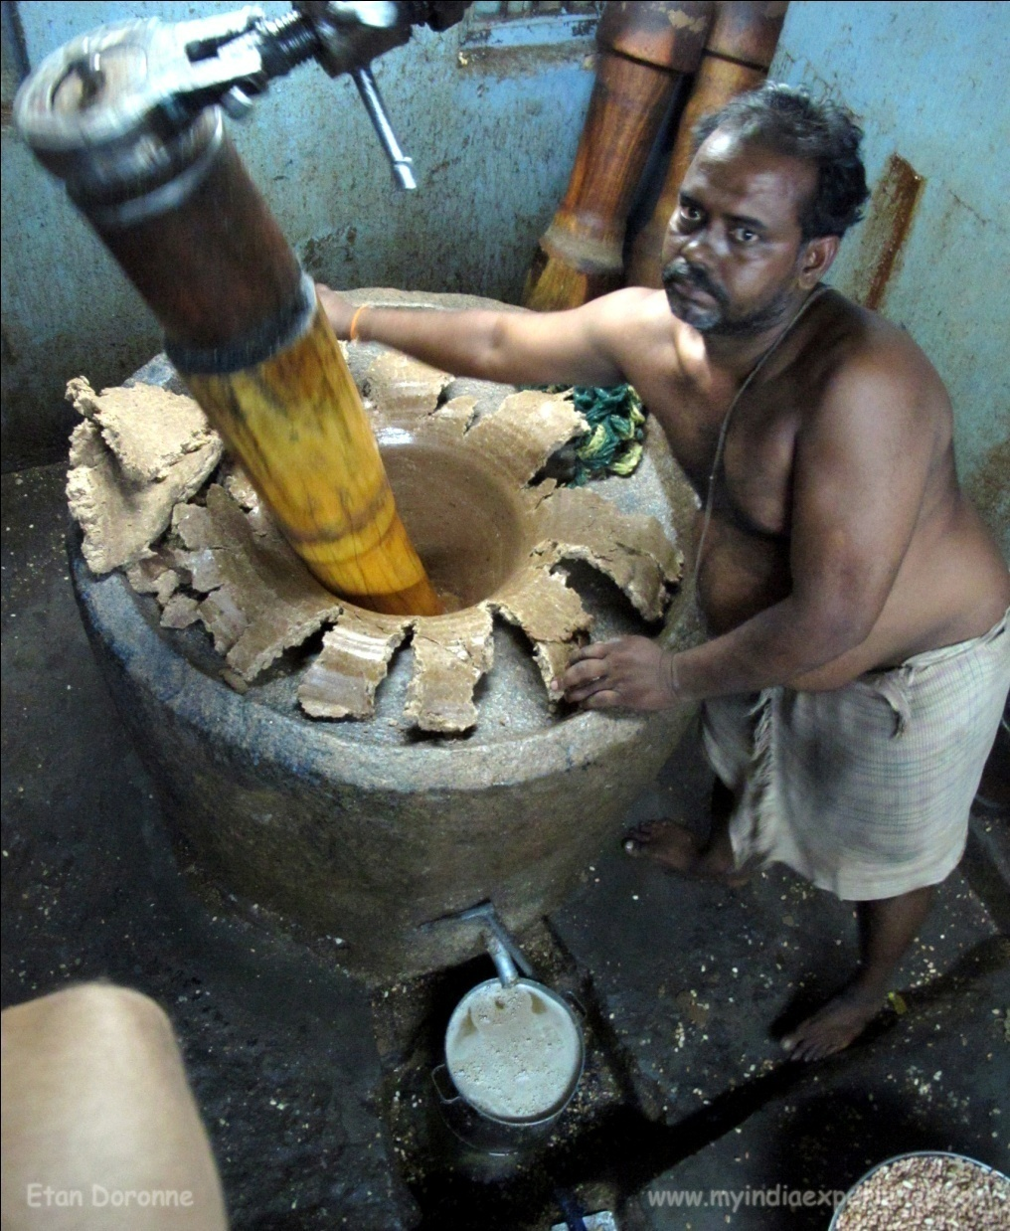
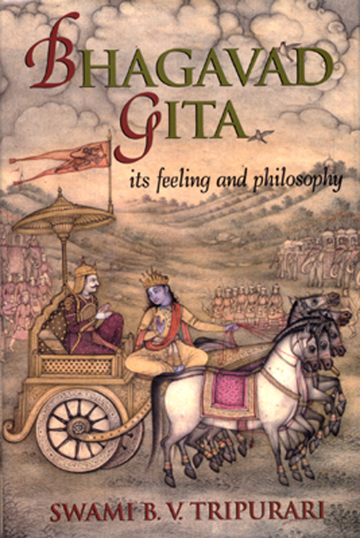
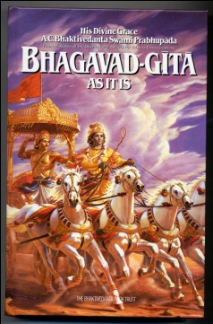
But, how can we get the ‘essence’ of Bhagavad Gita?
Extracting Machine

Slide 23
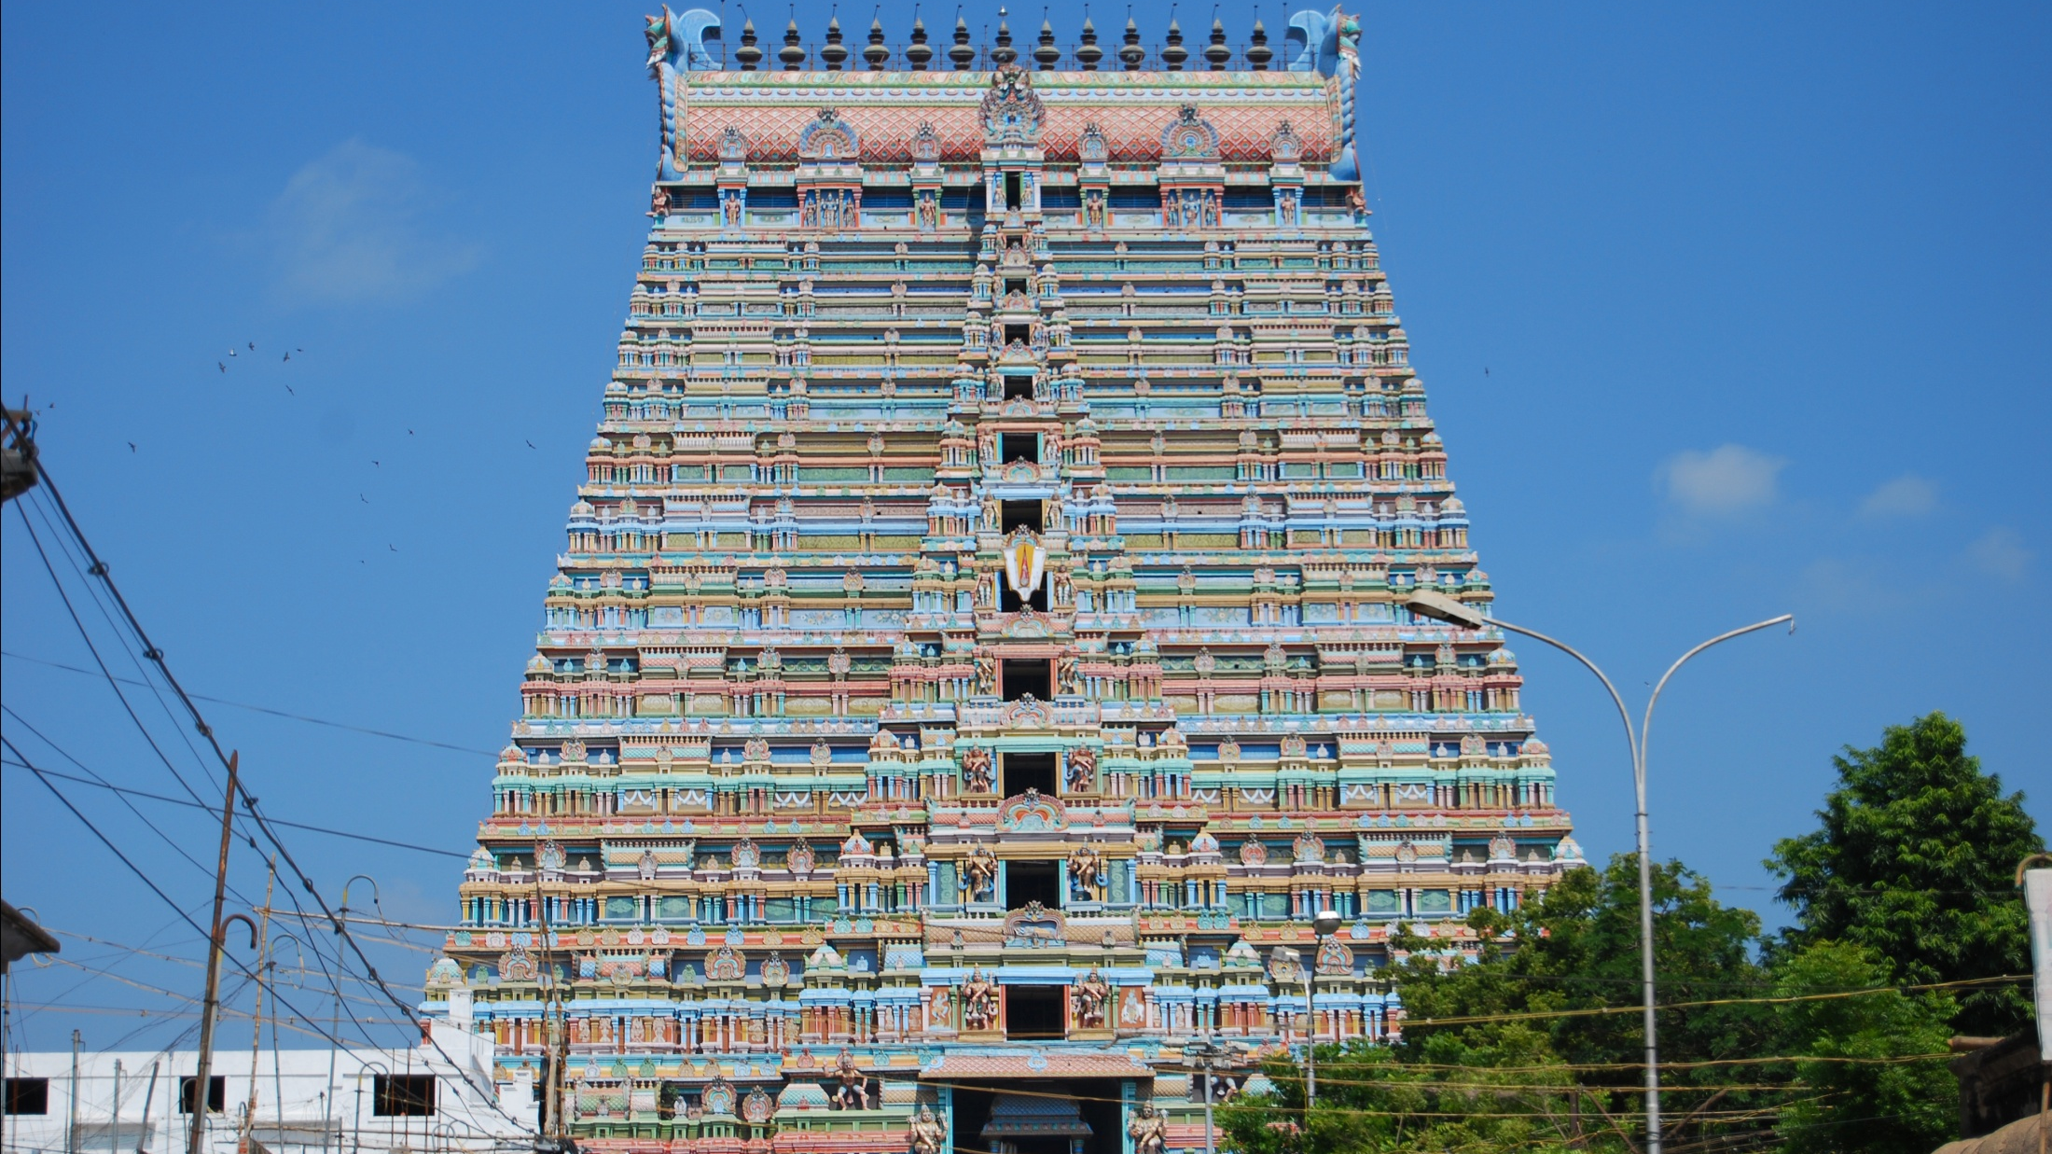
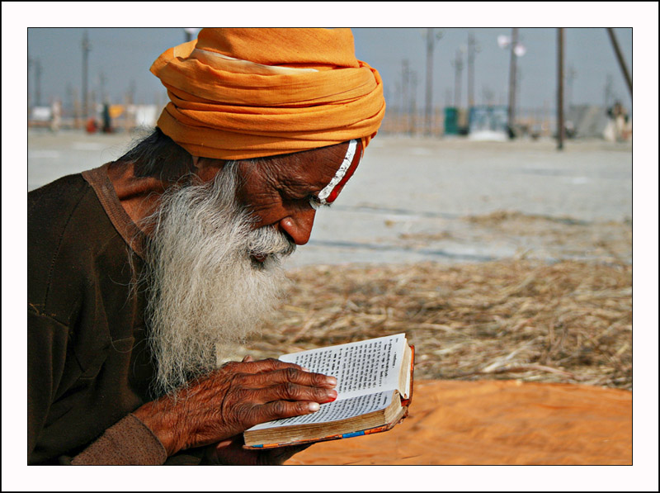
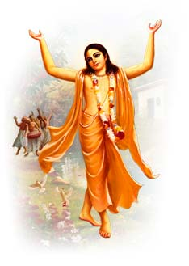

Slide 24
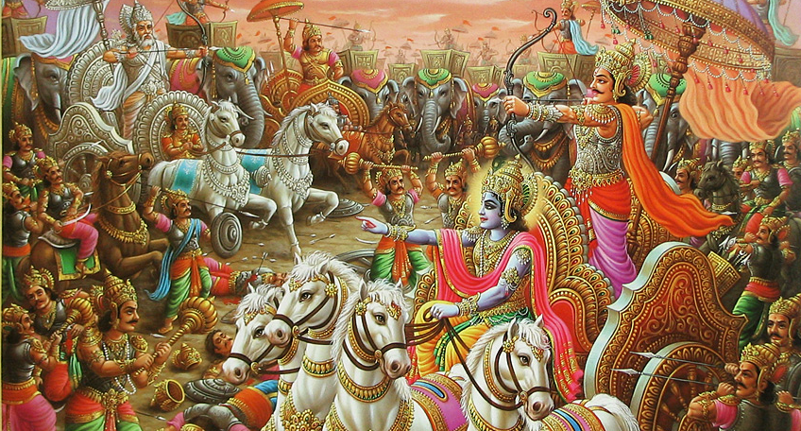
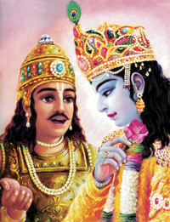
Gita has contradictions from starting to end.!
First Krishna says, do your dharma..
But what is at the end?

Slide 25
G2-04
Sarva-dharmān parityajya
Mām ekam śaraṇam vraja
Aham tvām sarva pāpebhyo
Mokṣayiṣyāmi mā śucah (B.G 18.66)
Vedic Studies deck…
Devarṣi-bhūtāpta nrṇām pitrṇām
Na kinkaro nāyam rṇī ca rājan
Sarvātmanā yaḥ śaraṇam śaraṇyam
Gato mukundam parihrtya kartam ........ (S.B. 11.5.41)

Slide 26
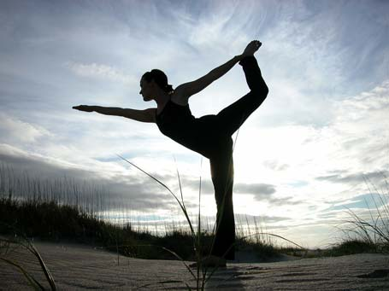
1. General Instructions
We are not bodies
Disciplines and Yoga
Nature of souls
Goal of jivas

Slide 27
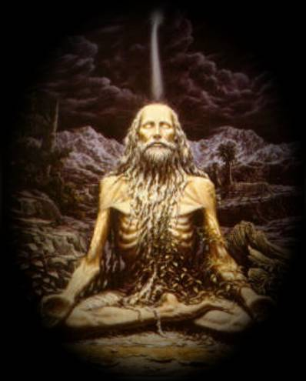
2. Secret Instructions
What is Brahman
Liberatation
Offering fruit of duties

Slide 28
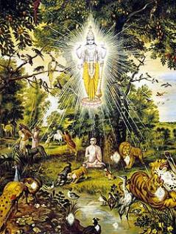
3. More Secret Instructions
Fallible souls
Infallible souls
Jivatma
Paramatma
Yogas & Yogies

Slide 29
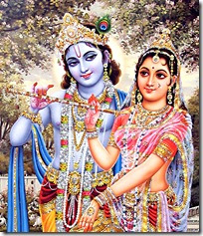
4. Most Secret Instructions
Guhyatam (Ch-9)
Bhakti Yoga

Slide 30
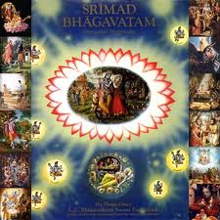
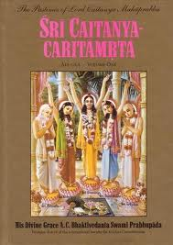
Starts With
Ends With
War
Saranagati
Sarnagati
Nama Sankirtan
Nama Sankirtan
Prema

Slide 31
What is the essence of Bhagavad Gita?
G2-03
Man-manā bhava mad-bhakto
Mad yājī mām namaskuru
Mām evaiṣyasi satyam te
Pratijāne priyo ’si me B.G 18.65
“Offer your mind to Me; become My bhakta; Worship Me and offer obeisances to Me. In this way, you will certainly come to Me. I promise you this truthfully because you are very dear to Me.”
Click for Vedic Studies

Slide 32
Similar one you studied earlier
Man-manā bhava mad-bhakto
Mad yājī mām namaskuru
Mām evaiṣyasi yuktaivam
Atmānam mat parāyanah B.G 9.34
Engage your mind always in thinking of Me, become My devotee, offer obeisances to Me and worship Me. Being completely absorbed in Me, surely you will come to Me.

Slide 33
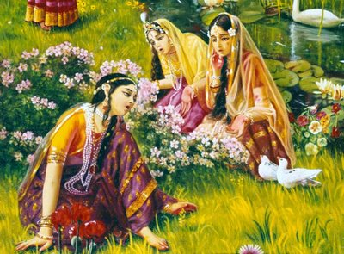
Man manā bhava…

Slide 34
Gopi Gita – Let us sing 1 to 9
Tava kathāmrtam tapta-jīvanam
Kavibhir īditam kalmaşāpaham
Śravaņa-mangalam šrīmad ātatam
Bhuvi grņanti ye bhūri-dā janāh
9
Click here for full deck…

Slide 35
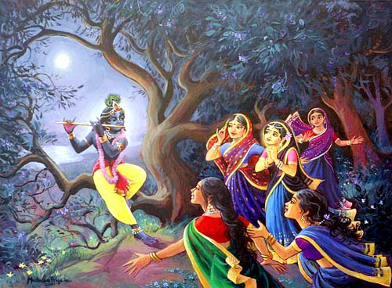
Vraja Gopis are the topmost example in remembering Krishna always…

Slide 36
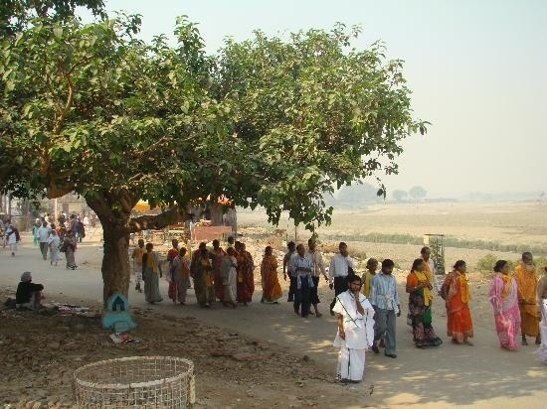
Once a newly married girl came to Vrindavan to live with her husband…
(Only after accumulating so much sukrti one gets that fortune)

Slide 37
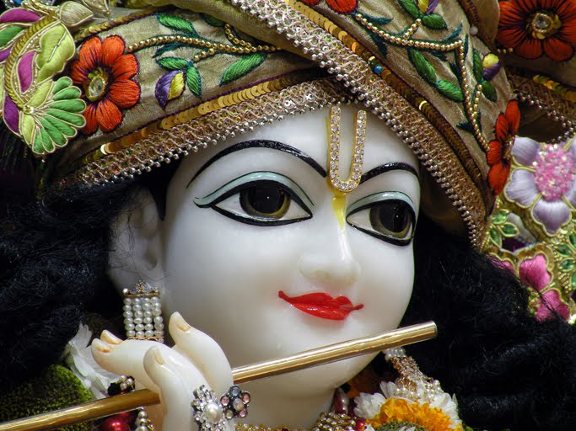
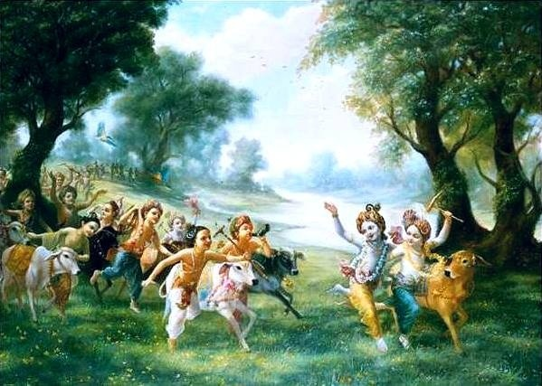
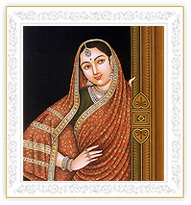
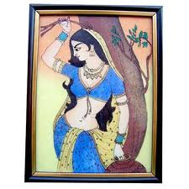
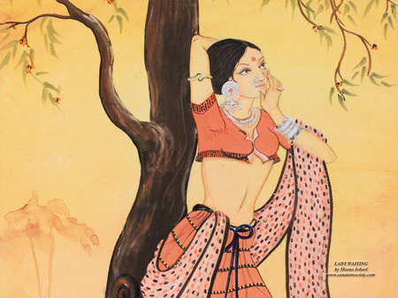
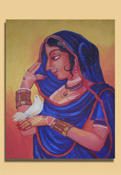
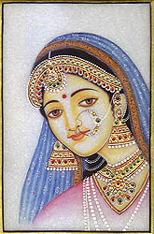
She heard about people flock to see Nanda Nandana herding the cows.

Slide 38
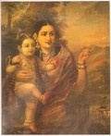
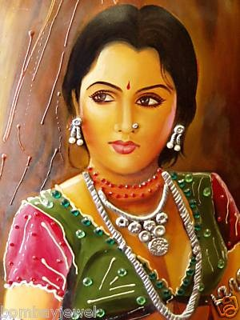
She asked her mother-in-law for permission to go outside and see..
But she was denied about a black snake. She was locked into the house.

Slide 39
Soon, she heard bugles and the gentle flute sound coming…
She could see outside only thru a key hole..
She peeked through the key hole of the door…

Slide 40
Krishna left the place as if nothing happened!
The dust was slowly settling…
The flute and sounds of His friends were fading away..

Slide 41
But, to the gopi..
Her heart was stolen!
She can never ever get it back!
Krishna left as if nothing happened.!

Slide 42
Her mother-in-law and sister-in-law returned, they were shocked to see her like a statue!
They immediately understood what might have happened…!

Slide 43
“Go and churn the butter!..” shouted the mother-in-law so that she can forget the incident….
But, thinking it as yogurt pot she took a mustard pot and started churning.!

Slide 44
When that did not work, she wanted to give some work where she can see the outside to forget the thoughts…
They asked her to fetch water from the well, and also gave a baby on her lap

Slide 45
What did she do at the well?
She was like mad…
Did not know what she was doing!
What did she do?

Slide 46
Bhakta āmā preme bāndhi-
Yāche hrdaya-bhitare
Yāhān netra pade tāhān
Dekhaye āmāre
Lord Krishna says, “My pure devotee binds Me in his heart with the ropes of prema, and sees only Me wherever he looks..”

Slide 47
That Gopi got the highest form of Krsna Bhakti because …?
Man mana bhava!

Slide 48
Great great yogis are struggling to remember Krishna!

Slide 49
But it is very difficult for them..!

Slide 50
They cannot hold even the paramatma form!
Yogies are struggling in birth after birth to get a glimpse of Paramatma!

Slide 51
In fact they have a big complaint!
Not the gopies..!

Slide 52
Gopi Gita – Verse 9
Tava kathāmrtam tapta-jīvanam
Kavibhir īditam kalmaşāpaham
Śravaņa-mangalam šrīmad ātatam
Bhuvi grņanti ye bhūri-dā janāh
For them, there is nothing other than Krishna! Perfect example of “Man Mana Bhava!”
Shyamala Sundara is always in their minds!

Slide 53
E-64
[O’ Shyamalā, O’ Sundarā
Cita Chorā Nanda Nandanā] ... (O Shyamala)
[O’ Mādhavā, Madhusūdhanā
Man Mana Mohanā Manmatā] ... (O Shyamala)
[O’ Keshavā, Giri Vardanā
Gopi Kāntā Yadhu Nandanā] ... (O Shyamala)
[O’ Vāmanā Vamsi Dhāraņā
Vana Mālā Hari Govindā!] ... (O Shyamala)

Slide 54
Sri Krsna Caitanya Prabhu Nityananda
Sri Advaita Gadadara Srivasadi
Gaura Bhakta Vrinda
Hare Krsna Hare Krsna
Krsna Krsna Hare Hare
Hare Rama Hare Rama
Rama Rama Hare Hare
THANK YOU!
Notes:
Om Ajnana timirandhasya, jnananjana salakaya
Caksur unmimiltam yena, tasmai sri gurave namah
Namah om vishnu padaya, radhikayah priyatmane
Sri-srimad bhaktivedanta, narayana iti namine
Sri krishna lila kathane sudaksham
Audarya-madhurya gunais ca yuktam
Varam varenyam purusham mahantam
Narayanam tvam sirasa namami
He krishna karuna sindho, dina bandho jagat pate
Gopesha gopika kanta, radha kanta namo ‘stu te
tapta kancana gaurangi, radhe vrindavaneshvari
vrsabhanu sute devi, pranamami hari priye
bhajami radham aravinda netram
smarami radham madhurasmi-tasyam
vadami radham karuna bharardram
tato mam anyasti gatir na kapi
bhaktya vihina aparadha lakshai
ksiptas ca kamadi taranga madhye
krpamayi tvam saranam prapanna
vrinde numas te caranara vindam

